Slide 1
Introduction of Storage Services, Hadoop & Mapreduce
Portions of this PPT draw from PPT authored by Professor Dijiang Huang at Arizona State University

Slide 2
Agenda
Storage Services
Concepts of Mapreduce/Hadoop
Hadoop 2.0 and YARN
References
“Data-Intensive Text Processing with MapReduce” by Jimmy Lin and Chris Dyer, University of Maryland, College Park
Internet

Slide 3
Storage Services

Slide 4
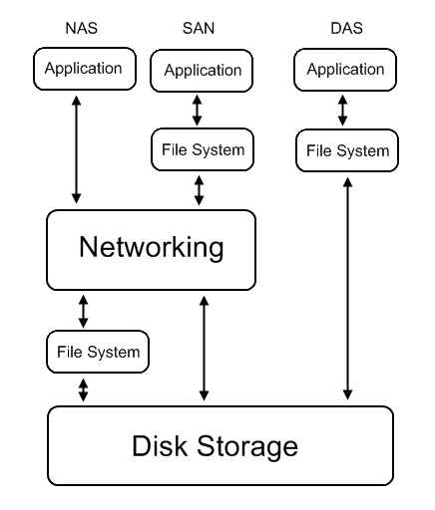
Introduction
Common storage architecture :
DAS - Direct Attached Storage
Storage device was directly attached to a server or workstation, without a storage network in between.
NAS - Network Attached Storage
File-level computer data storage connected to a computer network providing data access to heterogeneous clients.
SAN - Storage Area Network
Attach remote storage devices to servers in such a way that the devices appear as locally attached to the operating system.

Slide 5
File System Level
Data and Files
What is data ?
Data is information that has been converted to a machine-readable, digital binary format.
Control information indicates how data should be processed.
Applications may embed control information in user data for formatting or presentation.
Data and its associated control information is organized into discrete units as files or records.
What is file ?
Files are the common containers for user data, application code, and operating system executables and parameters.
Metadata
The control information for file management is known as metadata.
File metadata includes file attributes and pointers to the location of file data content.
File metadata may be segregated from a file's data content.
Metadata on file ownership and permissions is used in file access.
File timestamp metadata facilitates automated processes such as backup and life cycle management.

Slide 6
What To Be Virtualized
Layers can be virtualized
File system
Provide compatible system call interface to user space applications.
Block device
Provide compatible block device interface to file system.
Through the interface such as
SCSI (Small Computer System Interfaces)
SAS (Serial Attached SCSI)
ATA (a.k.a., IDE)
SATA (Serial ATA)
etc.
User Space
Application
System call interface
Kernel Space
File System
Block interface
Device driver
Storage Device

Slide 7
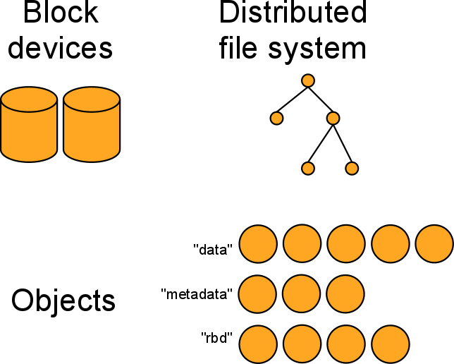
Notes:
RADOS Block Device (RBD)--reliable autonomic distributed object store (RADOS)
RBD is a Linux kernel feature that exposes RADOS storage as a block device.

Slide 8
GFS: Assumptions
Commodity hardware over “exotic” hardware
Scale “out”, not “up”
High component failure rates
Inexpensive commodity components fail all the time
“Modest” number of huge files
Multi-gigabyte files are common, if not encouraged
Files are write-once, mostly appended to
Perhaps concurrently
Large streaming reads over random access
High sustained throughput over low latency
GFS slides adapted from material by (Ghemawat et al., SOSP 2003)

Slide 9
GFS: Design Decisions
Files stored as chunks
Fixed size (64MB)
Reliability through replication
Each chunk replicated across 3+ chunkservers
Single master to coordinate access, keep metadata
Simple centralized management
No data caching
Little benefit due to large datasets, streaming reads
Simplify the API
Push some of the issues onto the client (e.g., data layout)
HDFS = GFS clone (same basic ideas)

Slide 10
From GFS to HDFS
Terminology differences:
GFS master = Hadoop namenode
GFS chunkservers = Hadoop datanodes
Functional differences:
No file appends in HDFS (planned feature)
HDFS performance is (likely) slower
For the most part, we’ll use the Hadoop terminology…

Slide 11
HDFS Architecture
HDFS namenode
Application
/foo/bar
(file name, block id)
File namespace
HDFS Client
block 3df2
(block id, block location)
instructions to datanode
(block id, byte range)
datanode state
HDFS datanode
HDFS datanode
block data
Linux file system
Linux file system
…
…
Adapted from (Ghemawat et al., SOSP 2003)

Slide 12
Namenode Responsibilities
Managing the file system namespace:
Holds file/directory structure, metadata, file-to-block mapping, access permissions, etc.
Coordinating file operations:
Directs clients to datanodes for reads and writes
No data is moved through the namenode
Maintaining overall health:
Periodic communication with the datanodes
Block re-replication and rebalancing
Garbage collection

Slide 13
Putting everything together…
namenode
job submission node
namenode daemon
jobtracker
tasktracker
tasktracker
tasktracker
datanode daemon
datanode daemon
datanode daemon
Linux file system
Linux file system
Linux file system
…
…
…
slave node
slave node
slave node

Slide 14
Ceph Design Goals
http://ceph.com/
Ceph replicates data and makes it fault-tolerant, using commodity hardware and requiring no specific hardware support. As a result of its design, the system is both self-healing and self-managing, aiming to minimize administration time and other costs.
Scalability
Storage capacity, throughput, client performance. Emphasis on HPC.
Reliability
“…failures are the norm rather than the exception…”
Performance
Dynamic workloads

Slide 15
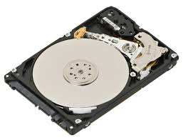
Object Based Storage: Separate the File System
Traditional Storage
Object-based Storage
Applications
Applications
System Call Interfaces
System Call Interfaces
Operating System
File System
File System Client Component
Operating System
Object Interface
Logic Block Interface
File System Storage Component
Object-based Storage Device (OSD)
Block I/O Manager
Block I/O Manager
Hard
Drive

Slide 16
Object Based Storage: Create MetaData
Applications
System Call Interfaces
Operating System
File System Client Component
MetaData Request
Data Request
MetaData Interface
MetaData Storage and/or System Management
Object Interface
File System MetaData Manager
File System Data Manager
MetaData
Server (MDS)
Object-based Storage Device (OSD)
MetaData Storage
Block I/O Manager

Slide 17
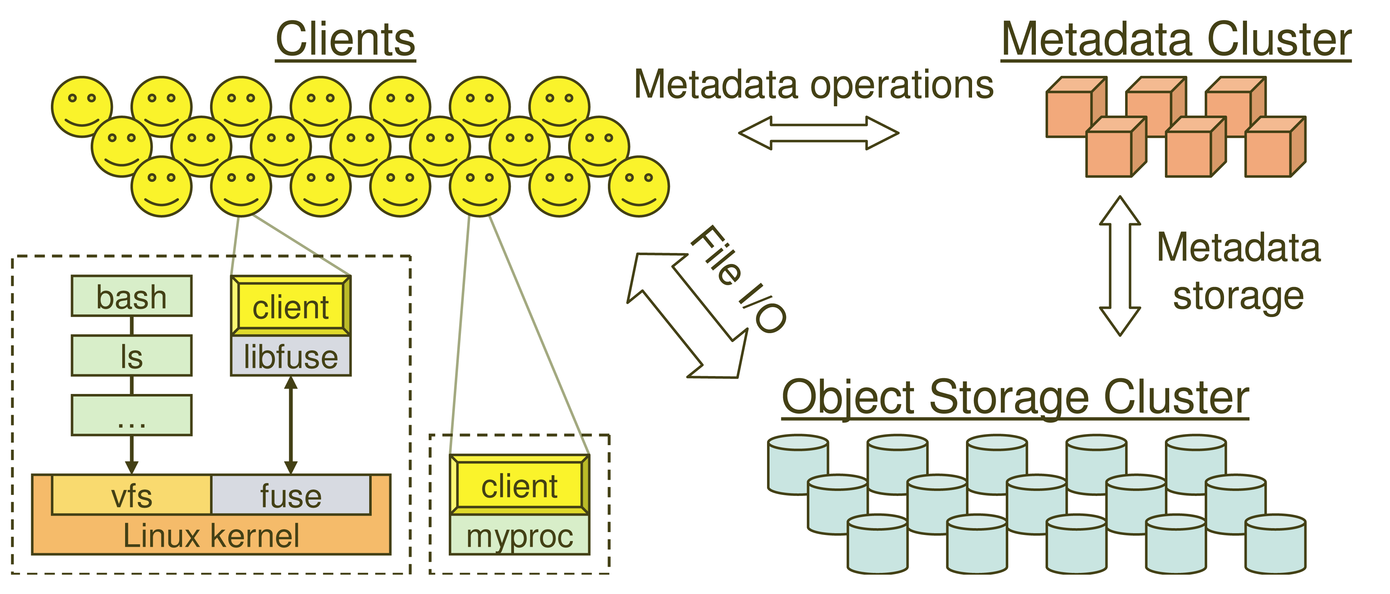
System Overview

Slide 18
Key Features
Decoupled data and metadata
CRUSH (Controlled Replication Under Scalable Hashing)
It is an algorithm that determines how to store and retrieve data by computing data storage locations.
Files striped onto predictably named objects
CRUSH maps objects to storage devices
Dynamic Distributed Metadata Management
Dynamic subtree partitioning
Distributes metadata amongst MDSs
Object-based storage
OSDs handle migration, replication, failure detection and recovery

Slide 19
Client Operation
Ceph interface
Nearly POSIX (Portable Operating System Interfaces)
Decoupled data and metadata operation
User space implementation
FUSE (File system in USErspace) or directly linked

Slide 20
Client Access Example
Client sends open request to MDS
MDS returns capability, file inode, file size and stripe information
Client read/write directly from/to OSDs
MDS manages the capability
Client sends close request, relinquishes capability, provides details to MDS

Slide 21
Synchronization
Adheres to POSIX
Includes HPC oriented extensions
Consistency / correctness by default
Optionally relax constraints via extensions
Extensions for both data and metadata
Synchronous I/O used with multiple writers or mix of readers and writers

Slide 22
Distributed Metadata
“Metadata operations often make up as much as half of file system workloads…”
MDSs use journaling
Repetitive metadata updates handled in memory
Optimizes on-disk layout for read access
Adaptively distributes cached metadata across a set of nodes

Slide 23
Distributed Object Storage
Files are split across objects
Objects are members of placement groups
Placement groups are distributed across OSDs.

Slide 24
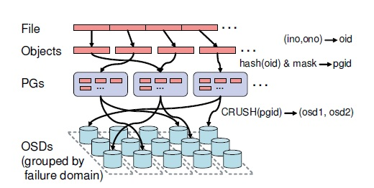
Separating Data and Metadata
Data Distribution with CRUSH
In order to avoid imbalance (OSD idle, empty) or load asymmetries (hot data on new device). →distributing new data randomly.
Use a simple hash function, Ceph maps objects to Placement groups (PGs). PGs are assigned to OSDs by CRUSH.

Slide 25
CRUSH
CRUSH(x) → (osd_{n1}, osd_{n2}, osd_{n3})
Inputs
x is the placement group
Hierarchical cluster map
Placement rules
Outputs a list of OSDs
Advantages
Anyone can calculate object location
Cluster map infrequently updated

Slide 26
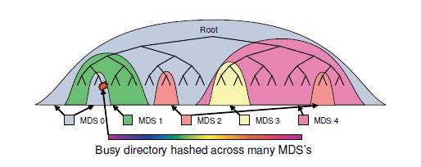
Dynamic Distributed Metadata Management
Dynamic Distributed Metadata Management
Ceph utilizes a metadata cluster architecture based on Dynamic Subtree Partitioning.(workload balance)
Dynamic Subtree Partitioning
Most FS ,use static subtree partitioning →imbalance workloads. →simple hash function can get directory.
Ceph’s MDS cluster is based on a dynamic subtree partitioning. →balance workloads

Slide 27
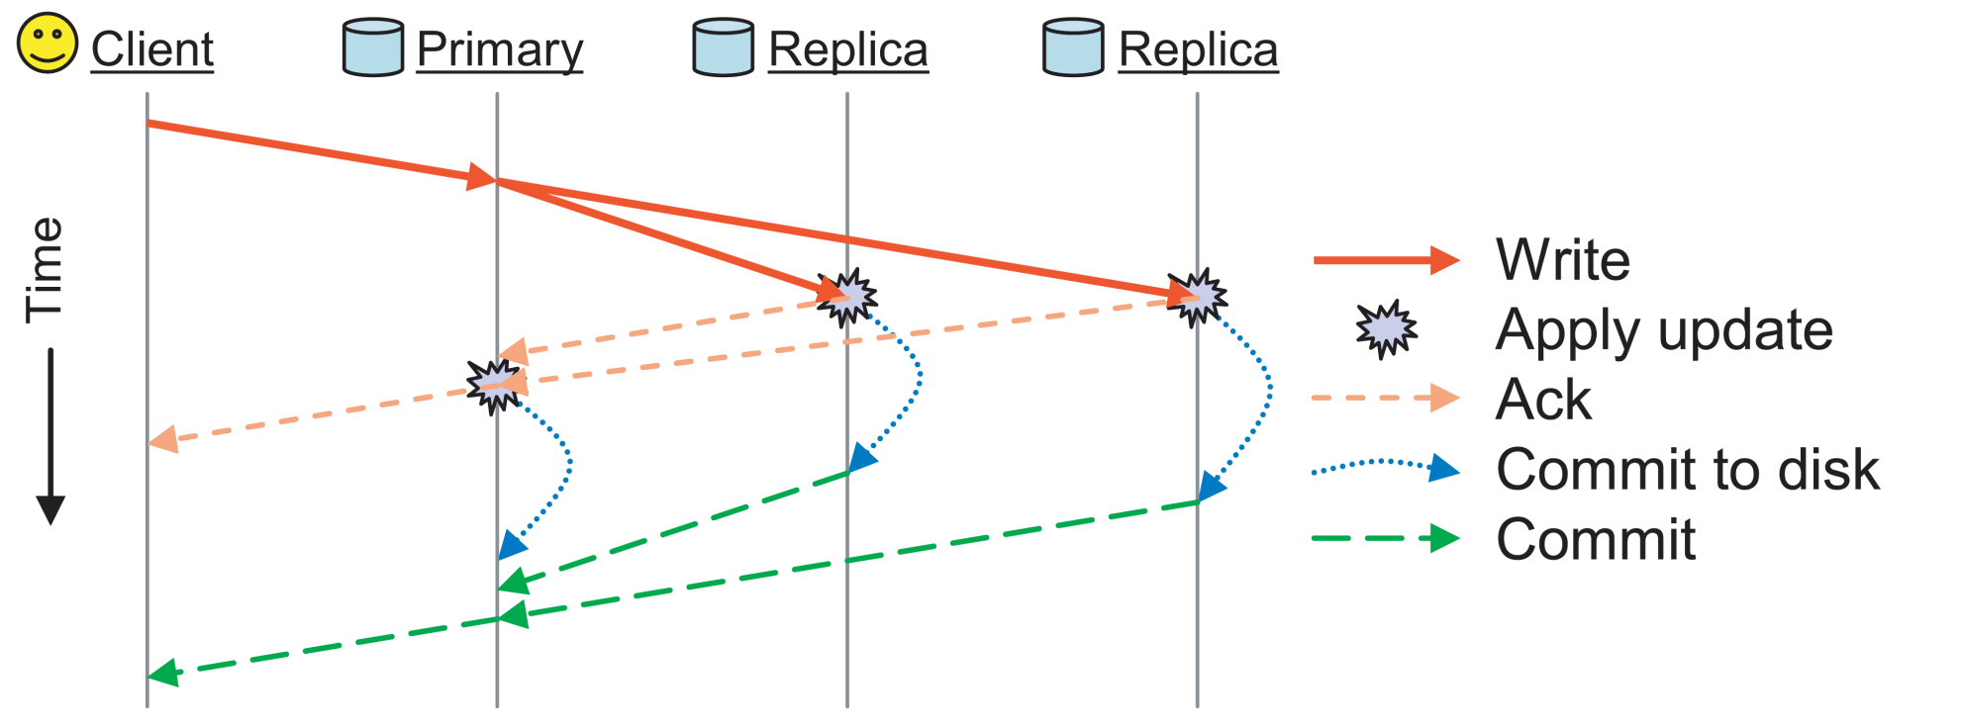
Replication
Objects are replicated on OSDs within same PG
Client is oblivious to replication

Slide 28
Failure Detection and Recovery
Down and Out
Monitors check for intermittent problems
New or recovered OSDs peer with other OSDs within PG

Slide 29
Related Links for Ceph
OBFS: A File System for Object-based Storage Devices
ssrc.cse.ucsc.edu/Papers/wang-mss04b.pdf
OSD
www.snia.org/tech_activities/workgroups/osd/
Ceph Presentation
http://institutes.lanl.gov/science/institutes/current/ComputerScience/ISSDM-07-26-2006-Brandt-Talk.pdf

Slide 30
Acronyms of Ceph
CRUSH: Controlled Replication Under Scalable Hashing
EBOFS: Extent and B-tree based Object File System
HPC: High Performance Computing
MDS: MetaData server
OSD: Object Storage Device
PG: Placement Group
POSIX: Portable Operating System Interface for uniX
RADOS: Reliable Autonomic Distributed Object Store

Slide 31
Hadoop Terminology
Google calls it: | Hadoop equivalent:
MapReduce | Hadoop
GFS | HDFS
Bigtable | HBase
Chubby | Zookeeper

Slide 32
Mapreduce

Slide 33

What is MapReduce?
Programming model for expressing distributed computations at a massive scale
Execution framework for organizing and performing such computations
Open-source implementation called Hadoop

Slide 34
Utility Computing
What?
Computing resources as a metered service (“pay as you go”)
Ability to dynamically provision virtual machines
Why?
Cost: capital vs. operating expenses
Scalability: “infinite” capacity
Elasticity: scale up or down on demand
Does it make sense?
Benefits to cloud users
Business case for cloud providers

Slide 35
Cloud Resources
Hadoop on your local machine
Hadoop in a virtual machine on your local machine
Hadoop in the Virtual Laboratory at CIDSE

Slide 36
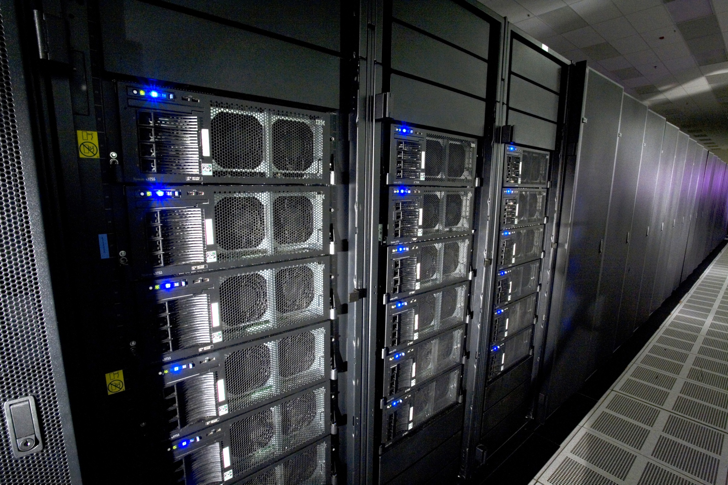
Source: Wikipedia (IBM Roadrunner)

Slide 37
Divide and Conquer
“Work”
Partition
w₁
w₂
w₃
“worker”
“worker”
“worker”
r₁
r₂
r₃
Combine
“Result”

Slide 38
Parallelization Challenges
How do we assign work units to workers?
What if we have more work units than workers?
What if workers need to share partial results?
How do we aggregate partial results?
How do we know all the workers have finished?
What if workers die?
What is the common theme of all of these problems?

Slide 39
Common Theme?
Parallelization problems arise from:
Communication between workers (e.g., to exchange state)
Access to shared resources (e.g., data)
Thus, we need a synchronization mechanism

Slide 40
Managing Multiple Workers
Difficult because
We don’t know the order in which workers run
We don’t know when workers interrupt each other
We don’t know the order in which workers access shared data
Thus, we need:
Semaphores (lock, unlock)
Conditional variables (wait, notify, broadcast)
Barriers
Still, lots of problems:
Deadlock, livelock, race conditions...
Dining philosophers, sleeping barbers, cigarette smokers...
Moral of the story: be careful!
Notes:
DEADLOCK Deadlock is a condition in which a task waits indefinitely for conditions that can never be satisfied - task claims exclusive control over shared resources - task holds resources while waiting for other resources to be released - tasks cannot be forced to relinguish resources - a circular waiting condition exists
LIVELOCK Livelock conditions can arise when two or more tasks depend on and use the some resource causing a circular dependency condition where those tasks continue running forever, thus blocking all lower priority level tasks from running (these lower priority tasks experience a condition called starvation)
A livelock is similar to a deadlock, except that the states of the processes involved in the livelock constantly change with regard to one another, none progressing. Livelock is a special case of resource starvation; the general definition only states that a specific process is not progressing.
A real-world example of livelock occurs when two people meet in a narrow corridor, and each tries to be polite by moving aside to let the other pass, but they end up swaying from side to side without making any progress because they both repeatedly move the same way at the same time.
Livelock is a risk with some algorithms that detect and recover from deadlock. If more than one process takes action, the deadlock detection algorithm can be repeatedly triggered. This can be avoided by ensuring that only one process (chosen randomly or by priority) takes action.
http://en.wikipedia.org/wiki/Dining_philosophers_problem In computer science, the dining philosophers problem is an example problem often used in concurrent algorithm design to illustrate synchronization issues and techniques for resolving them.
http://en.wikipedia.org/wiki/Sleeping_barber_problem n computer science, the sleeping barber problem is a classic inter-process communication and synchronization problem between multiple operating system processes. The problem is analogous to that of keeping a barber working when there are customers, resting when there are none and doing so in an orderly manner.
The analogy is based upon a hypothetical barber shop with one barber. The barber has one barber chair and a waiting room with a number of chairs in it. When the barber finishes cutting a customer's hair, he dismisses the customer and then goes to the waiting room to see if there are other customers waiting. If there are, he brings one of them back to the chair and cuts his hair. If there are no other customers waiting, he returns to his chair and sleeps in it.
http://en.wikipedia.org/wiki/Cigarette_smokers_problem Assume there are also three chain smokers around a table, each of whom has an infinite supply of one of the three ingredients — one smoker has an infinite supply of tobacco, another has an infinite supply of paper, and the third has an infinite supply of matches.
Assume there is also a non-smoking arbiter. The arbiter enables the smokers to make their cigarettes by arbitrarily (non deterministically) selecting two of the smokers, taking one item out of each of their supplies, and placing the items on the table. The arbiter then notifies the third smoker that they have done this. The third smoker removes the two items from the table and uses them (along with their own supply) to make a cigarette, which they smoke for a while. Meanwhile, the arbiter, seeing the table empty, again chooses two smokers at random and places their items on the table. This process continues forever.
The smokers do not hoard items from the table; a smoker only begins to roll a new cigarette once they have finished smoking the last one. For instance if the arbiter places tobacco and paper on the table while the match-supply smoker is smoking, the tobacco and paper will remain untouched on the table until the match-supply smoker is finished with their cigarette and then collects the items.

Slide 41
Current Tools
Programming models
Shared memory (pthreads)
Message passing (MPI)
Design Patterns
Master-slaves
Producer-consumer flows
Shared work queues
Shared Memory
Message Passing
Memory
P₁
P₂
P₃
P₄
P₅
P₁
P₂
P₃
P₄
P₅
producer
consumer
master
work queue
slaves
producer
consumer

Slide 42
Where the rubber meets the road
Concurrency is difficult to reason about
Concurrency is even more difficult to reason about
At the scale of datacenters (even across datacenters)
In the presence of failures
In terms of multiple interacting services
Not to mention debugging…
The reality:
Lots of one-off solutions, custom code
Write you own dedicated library, then program with it
Burden on the programmer to explicitly manage everything

Slide 43
What’s the point?
It’s all about the right level of abstraction
The von Neumann architecture has served us well, but is no longer appropriate for the multi-core/cluster environment
Hide system-level details from the developers
No more race conditions, lock contention, etc.
Separating the what from how
Developer specifies the computation that needs to be performed
Execution framework (“runtime”) handles actual execution
The datacenter is the computer!
Notes:
http://en.wikipedia.org/wiki/Von_Neumann_architecture

Slide 44
“Big Ideas”
Scale “out”, not “up”
Limits of Symmetric Multiprocessing (SMP) and large shared-memory machines
Move processing to the data
Cluster have limited bandwidth
Process data sequentially, avoid random access
Seeks are expensive, disk throughput is reasonable
Seamless scalability
From the mythical man-month to the tradable machine-hour

Slide 45
MapReduce

Slide 46
Typical Large-Data Problem
Iterate over a large number of records
Extract something of interest from each
Shuffle and sort intermediate results
Aggregate intermediate results
Generate final output
Map
Reduce
Key idea: provide a functional abstraction for these two operations
(Dean and Ghemawat, OSDI 2004)

Slide 47
Roots in Functional Programming
MapReduce
Map
f
f
f
f
f
Fold
g
g
g
g
g
Illustration of map and fold , two higher-order functions commonly used together in functional programming: map takes a function f and applies it to every element in a list, while fold iteratively applies a function g to aggregate results.

Slide 48
MapReduce
Programmers specify two functions:
map (k₁, v₁) → [(k₂, v₂)]
reduce (k₂, [v₂]) → [(k₃, v₃)]
All values with the same key are sent to the same reducer
The execution framework handles everything else…
denote a list

Slide 49
MapReduce
k₁
v₁
k₂
v₂
k₃
v₃
k₄
v₄
k₅
v₅
k₆
v₆
map
map
map
map
a
1
b
2
c
3
c
6
a
5
c
2
b
7
c
8
Shuffle and Sort: aggregate values by keys
a
1
5
b
2
7
c
2
3
6
8
reduce
reduce
reduce
r₁
s₁
r₂
s₂
r₃
s₃

Slide 50
MapReduce
Programmers specify two functions:
map (k₁, v₁) → [(k₂, v₂)]
reduce (k₂, [v₂]) → [(k₃, v₃)]
All values with the same key are sent to the same reducer
The execution framework handles everything else…
What’s “everything else”?

Slide 51
MapReduce “Runtime”
Handles scheduling
Assigns workers to map and reduce tasks
Handles “data distribution”
Moves processes to data
Handles synchronization
Gathers, sorts, and shuffles intermediate data
Handles errors and faults
Detects worker failures and restarts
Everything happens on top of a distributed FS (later)

Slide 52
MapReduce
Programmers specify two functions:
map (k₁, v₁) → [(k₂, v₂)]
reduce (k₂, [v₂]) → [(k₃, v₃)]
All values with the same key are reduced together
The execution framework handles everything else…
Not quite…usually, programmers also specify:
partition (k₂, number of partitions) → partition for k₂
Often a simple hash of the key, e.g., hash(k₂) mod n
Divides up key space for parallel reduce operations
combine (k₂, [v₂]) → [(k₃, v₃)]
Mini-reducers that run in memory after the map phase
Used as an optimization to reduce network traffic

Slide 53
k₁
v₁
k₂
v₂
k₃
v₃
k₄
v₄
k₅
v₅
k₆
v₆
map
map
map
map
a
1
b
2
c
3
c
6
a
5
c
2
b
7
c
8
combine
combine
combine
combine
a
1
b
2
c
9
a
5
c
2
b
7
c
8
partition
partition
partition
partition
Shuffle and Sort: aggregate values by keys
a
1
5
b
2
7
c
c
2
2
9
3
8
6
8
reduce
reduce
reduce
r₁
s₁
r₂
s₂
r₃
s₃

Slide 54
Two more details…
Barrier between map and reduce phases
But we can begin copying intermediate data earlier
Keys arrive at each reducer in sorted order
No enforced ordering across reducers

Slide 55
“Hello World”: Word Count
Map(String docid, String text):
for each word w in text:
Emit(w, 1);
Reduce(String term, Iterator<Int> values):
int sum = 0;
for each v in values:
sum += v;
Emit(term, value);

Slide 56
MapReduce can refer to…
The programming model
The execution framework (aka “runtime”)
The specific implementation

Slide 57
MapReduce Implementations
Google has a proprietary implementation in C++
Bindings in Java, Python
Hadoop is an open-source implementation in Java
Development led by Yahoo, used in production
Now an Apache project
Rapidly expanding software ecosystem
Lots of custom research implementations
For GPUs, cell processors, etc.

Slide 58
User Program
(1) submit
Master
(2) schedule map
(2) schedule reduce
worker
split 0
(6) write
output
file 0
split 1
(5) remote read
worker
split 2
(3) read
(4) local write
split 3
worker
split 4
worker
output
file 1
worker
Input
files
Map
phase
Intermediate files
(on local disk)
Reduce
phase
Output
files
Adapted from (Dean and Ghemawat, OSDI 2004)

Slide 59

How do we get data to the workers?
NAS
SAN
Compute Nodes
What’s the problem here?

Slide 60
Distributed File System
Don’t move data to workers… move workers to the data!
Store data on the local disks of nodes in the cluster
Start up the workers on the node that has the data local
Why?
Not enough RAM to hold all the data in memory
Disk access is slow, but disk throughput is reasonable
A distributed file system is the answer
GFS (Google File System) for Google’s MapReduce
HDFS (Hadoop Distributed File System) for Hadoop

Slide 61
Recap
Why large data?
Cloud computing and MapReduce
Large-data processing: “big ideas”
What is MapReduce?
Importance of the underlying distributed file system

Slide 62
Hadoop 2.0 and YARN

Slide 63
YARN
Yet Another Resource Negotiator
YARN Application Resource Negotiator (Recursive Acronym)
Remedies the scalability shortcomings of “classic” MapReduce
Is more of a general purpose framework of which classic mapreduce is one application.

Slide 64
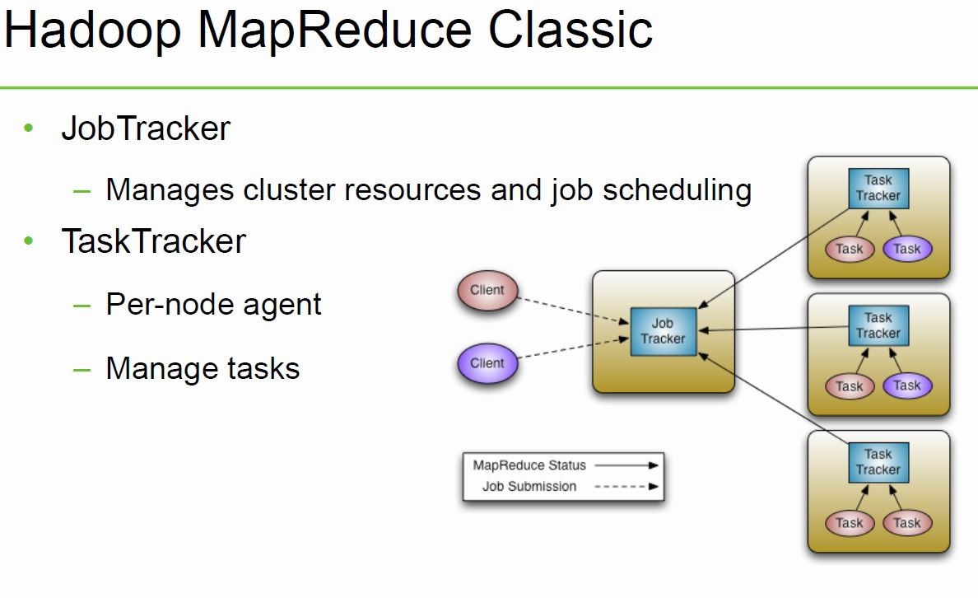

Slide 65
MapReduce Limitations
Scalability
Maximum Cluster Size – 4000 Nodes
Maximum Concurrent Tasks – 40000
Coarse synchronization in Job Tracker
Single point of failure
Failure kills all queued and running jobs
Jobs need to be resubmitted by users
Restart is very tricky due to complex state

Slide 66
YARN
Splits up the two major functions of JobTracker
Global Resource Manager - Cluster resource management
Application Master - Job scheduling and monitoring (one per application). The Application Master negotiates resource containers from the Scheduler, tracking their status and monitoring for progress. Application Master itself runs as a normal container.
Tasktracker
NodeManager (NM) - A new per-node slave is responsible for launching the applications’ containers, monitoring their resource usage (cpu, memory, disk, network) and reporting to the Resource Manager.
YARN maintains compatibility with existing MapReduce applications and users.

Slide 67
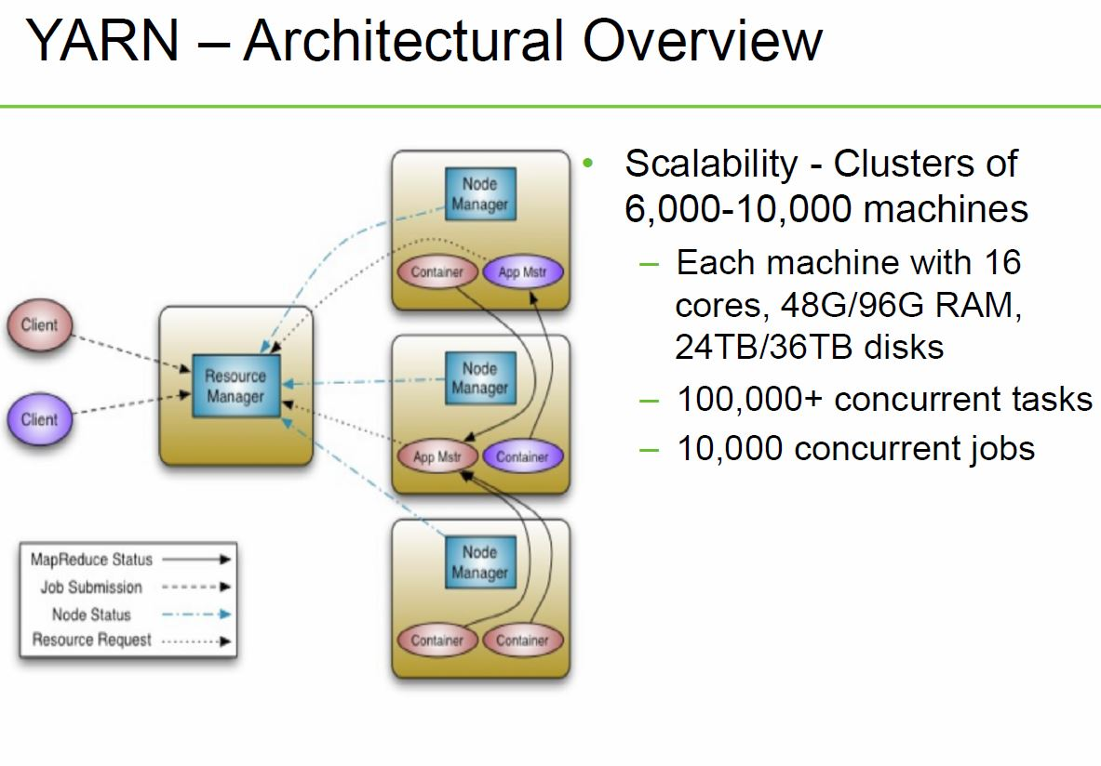

Slide 68
Classic MapReduce vs. YARN
Fault Tolerance and Availability
Resource Manager
No single point of failure – state saved in ZooKeeper
Application Masters are restarted automatically on RM restart
Application Master
Optional failover via application-specific checkpoint
MapReduce applications pick up where they left off via state saved in HDFS
Wire Compatibility
Protocols are wire-compatible
Old clients can talk to new servers
Rolling upgrades

Slide 69
Classic MapReduce vs. YARN
Support for programming paradigms other than MapReduce (Multi tenancy)
Tez – Generic framework to run a complex DAG
HBase on YARN(HOYA)
Machine Learning: Spark
Graph processing: Giraph
Real-time processing: Storm
Enabled by allowing the use of paradigm-specific application master
Run all on the same Hadoop cluster!

Slide 70
Storm on YARN
Motivations
Collocating real-time processing with batch processing
Provides a huge potential for elasticity.
Reduces network transfer rates by moving storm closer to Mapreduce.
Notes:
Collocating real-time processing with batch processing offers a number of advantages over segregated clusters.
It provides a huge potential for elasticity. Real-time processing will rarely produce a constant and predictable load. As such, Storm needs more resources to keep up with spikes in demand. Collocating Storm with batch processing allows Storm to steal resources from batch jobs when needed and give them back when demand subsides. The Storm-YARN effort lays the groundwork to make this possible.
Many applications use Storm for low-latency processing and Map/Reduce for batch processing while sharing data between Storm and Map/Reduce. By placing Storm physically closer to the data source and/or other components in the same pipeline we can reduce network transfers and in turn the total cost of acquiring the data.

Slide 71
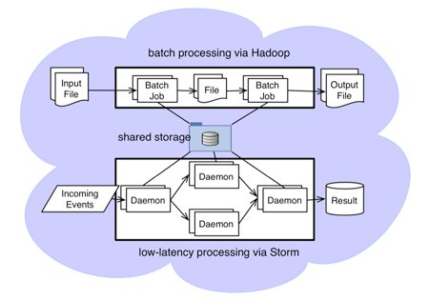
Storm on YARN @Yahoo
Notes:
To compute user interest, Yahoo process billions of events from our over 700 million users, and analyze 2.2 billion content every day. Since users' change interest over time, we need to update user profiles to reflect their current interests.

Slide 72
Storm on YARN @Yahoo
Yahoo enhanced Storm to support Hadoop style security mechanisms
Storm is being integrated into Hadoop YARN for resource management.
Storm-on-YARN enables Storm applications to utilize the computational resources in our tens of thousands of Hadoop computation nodes.
YARN is used to launch the Storm application master (Nimbus) on demand, and enables Nimbus to request resources for Storm application slaves (Supervisors).
Notes:
Yahoo enhanced Storm to support Hadoop style security mechanisms (including Kerberos authentication), and thus enable Storm applications to access Hadoop datasets stored in our secure HDFS and Hbase clusters.
Storm is being integrated into Hadoop YARN for resource management. Storm-on-YARN enables Storm applications to utilize the computational resources in our tens of thousands of Hadoop computation nodes. YARN is used to launch the Storm application master (Nimbus) on demand, and enables Nimbus to request resources for Storm application slaves (Supervisors).

Slide 73
Tez on YARN
Hindi for speed
Currently in development
Provides a general-purpose, highly customizable framework that creates simplifies data-processing tasks across both small scale (low-latency) and large-scale (high throughput) workloads in Hadoop.
Generalizes the MapReduce paradigm to a more powerful framework by providing the ability to execute a complex DAG
Enables Apache Hive, Apache Pig and Cascading can meet requirements for human-interactive response times and extreme throughput at petabyte scale

Slide 74
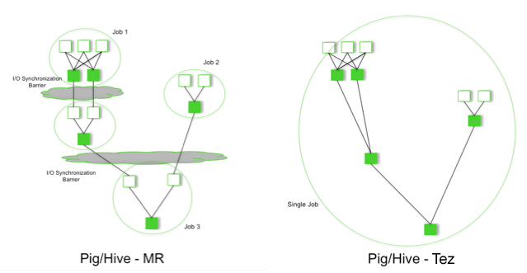
Tez on YARN

Slide 75
Tez on YARN
Performance gains over Mapreduce
Eliminates replicated write barrier between successive computations
Eliminates job launch overhead of workflow jobs
Eliminates extra stage of map reads in every workflow job
Eliminates queue and resource contention suffered by workflow jobs that are started after a predecessor job completes

Slide 76
Tez on YARN
Is part of the Stinger Initiative
Should be deployed as part of Phase 2

Slide 77
HBase on YARN(HOYA)
Currently in prototype
Be able to create on-demand HBase clusters easily -by and or in apps
With different versions of HBase potentially (for testing etc.)
Be able to configure different HBase instances differently
For example, different configs for read/write workload instances
Better isolation
Run arbitrary co-processors in user’s private cluster
User will own the data that the HBase daemons create

Slide 78
HBase on YARN(HOYA)
MR jobs should find it simple to create (transient) HBase clusters
For Map-side joins where table data is all in HBase, for example
Elasticity of clusters for analytic / batch workload processing
Stop / Suspend / Resume clusters as needed
Expand / shrink clusters as needed
Be able to utilize cluster resources better
Run MR jobs while maintaining HBase’s low latency SLAs

Slide 79
Classic MapReduce vs. YARN
Multi-tenancy, being able to run multiple paradigms simultaneously is a big plus.

Slide 80
Hadoop 2.0
So Hadoop 2.0 includes YARN, High Availability and Federation
High Availability takes away the Single Point of failure from namenode and introduces the concept of the QuorumJournalNodes to sync edit logs between active and standby namenodes
Federation allows multiple independent namespaces(private namespaces, or hadoop as a service)

